Slide 1
Making TANF Work
for Poor Families
Deborah Weinstein dweinstein@chn.org
October 15, 2016

Slide 2
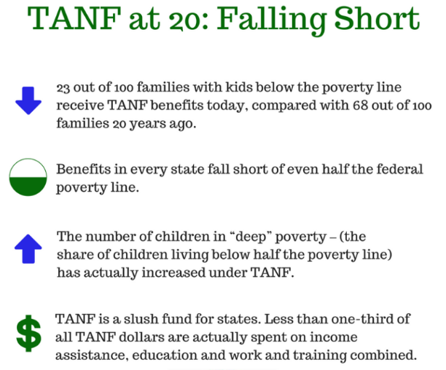

Slide 3
TANF Provides a Safety Net to a
Small Share of Poor Families

Slide 4
Nationwide, TANF cash assistance averaged $398 per month in 2015.
No state has benefits that exceed half the federal poverty line.
Since 1996, benefits have fallen by 20 percent or more in 35 states plus D.C., after adjusting for inflation.

Slide 5
Too many poor children
6.5m children below half poverty line
131,000 children below half poverty line

Slide 6
TANF Cases Have Declined Dramatically, Even When Poverty, and Deep Poverty, Increased
Notes:
Focus on deep poverty

Slide 7
Many factors increased single moms’ work in the 90’s: jobs, EITC, child care and TANF.

Slide 8
As the Number of Unemployed Single Parents Increased, the Number Served by AFDC/TANF Fell
Source: AFDC/TANF Characteristics and Financial Circumstances Reports, CBPP analysis of Basic Monthly CPS data.
Notes:
REPLACE WITH UPDATED VERSION

Slide 9
TANF isn’t working as a welfare to work program

Slide 10
Education credentials work
Colorado Works program (TANF) findings:
$416 per quarter: average gain for those with short-term credential
$2,200 per quarter: average gain for those with Assoc. of Applied Sciences degree
(nationwide, close to 4 in 10 TANF adults haven’t finished HS)

Slide 11
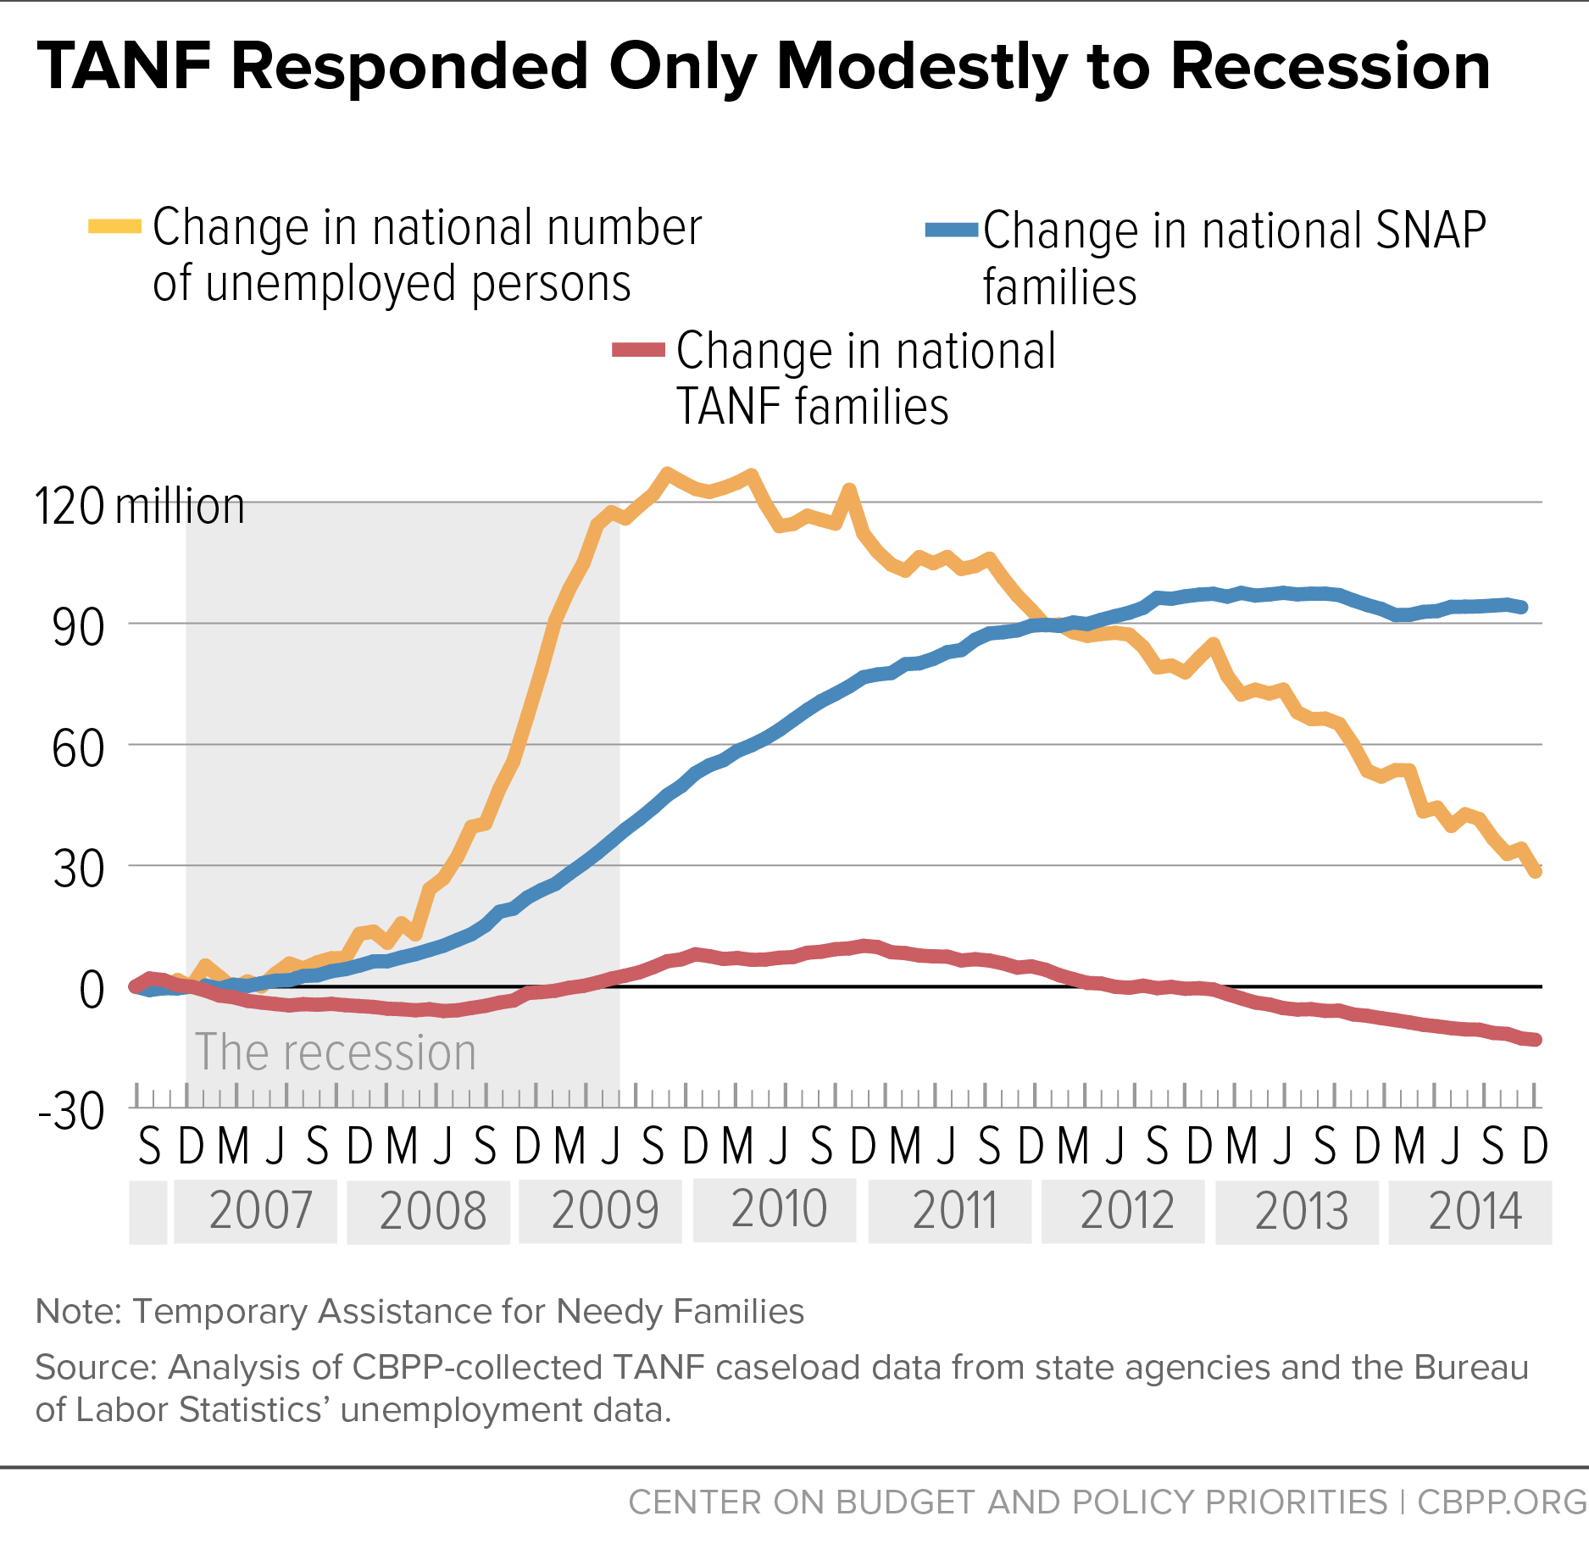
Unlike SNAP, TANF Proved Not Responsive to Changes in the Economy
11

Slide 12
Gray: less than 25% Blue: 50% - 74% Turquoise: 25% - 49% Green: More than 75%

Slide 13
Change in Spending on Selected Categories Over Time
not adjusted for inflation

Slide 14
What to do…
States should serve more of the poorest families.
States should spend a minimum percent of their state and federal TANF funds on basic assistance, child care and work.
The work participation rate/caseload reduction credit should be replaced with an employment outcome measure.

Slide 15
More to do…
Provide competitive grant funds to find the best ways to help people overcome barriers to work.
Allow more education/training.
Increase federal funding for TANF – the block grant has fallen in value by more than one-third over the past 20 years.
Create a federal recession response fund.

Slide 16
Still more to do…
Recognize TANF must work with other programs/policies:
Raise the minimum wage
Increase funds for child care
Paid leave
Improve SNAP, child nutrition programs
More housing vouchers
Modernized unemployment insurance program

